Slide 1
Tool Checkout Vending Machine
May 1416

Slide 2
The Project
Tool Checkout Vending Machine
Similar to a library lending arrangement
Students swipe ID and select desired product
Tool record added to authorized student database
Admin checks in returned tools in CSG electronic shop, modifies student database
Admin can modify tools and edit inventory

Slide 3
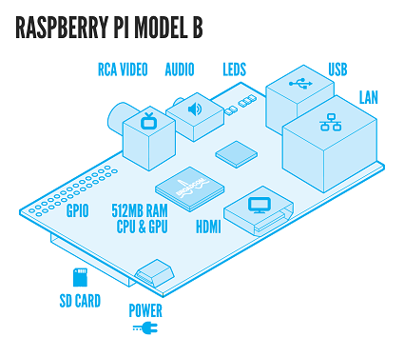
Raspberry Pi
Why?
Needed video output for LCD on front panel
Capable of USB attachments and hub.
Advisor/client recommended
Department had a spare model in stock
Confidence in ability to work with and program

Slide 4
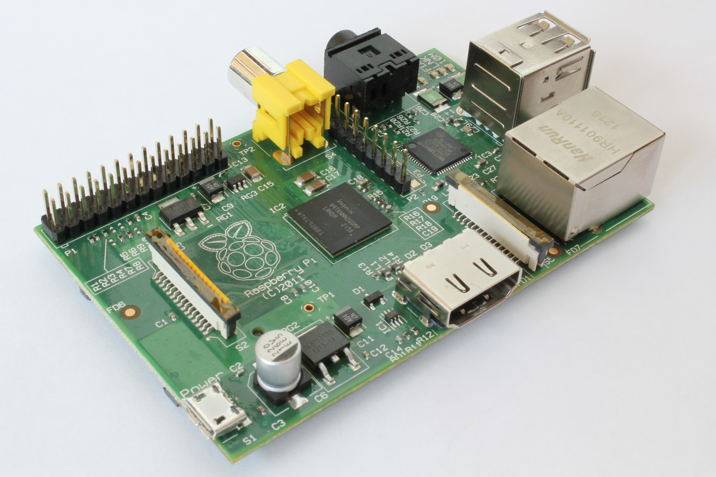
Raspberry Pi
Apache Server
Provides administrator websites
Database
Student Information
Tool Inventory
Python Scripts
GPIO Pins
Motors
Matrix Keypad

Slide 5
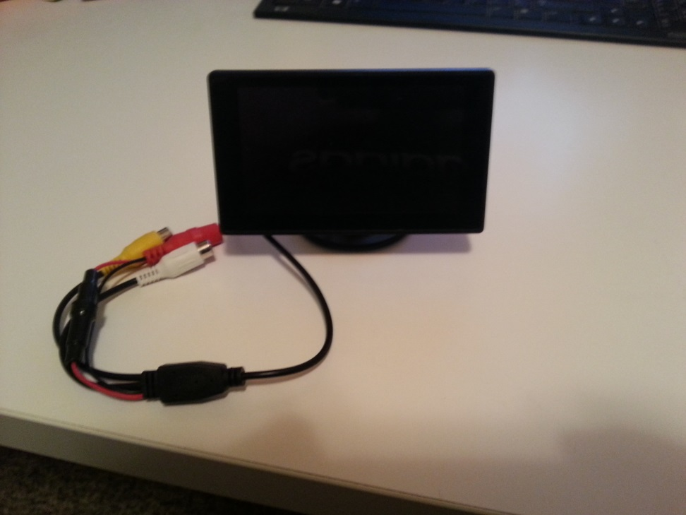
LCD
Connects to RCA video output on Raspberry Pi
Displays full screen responses to user through Pygame module use
Main program code sends strings and text positions to Pygame methods to update screen

Slide 6
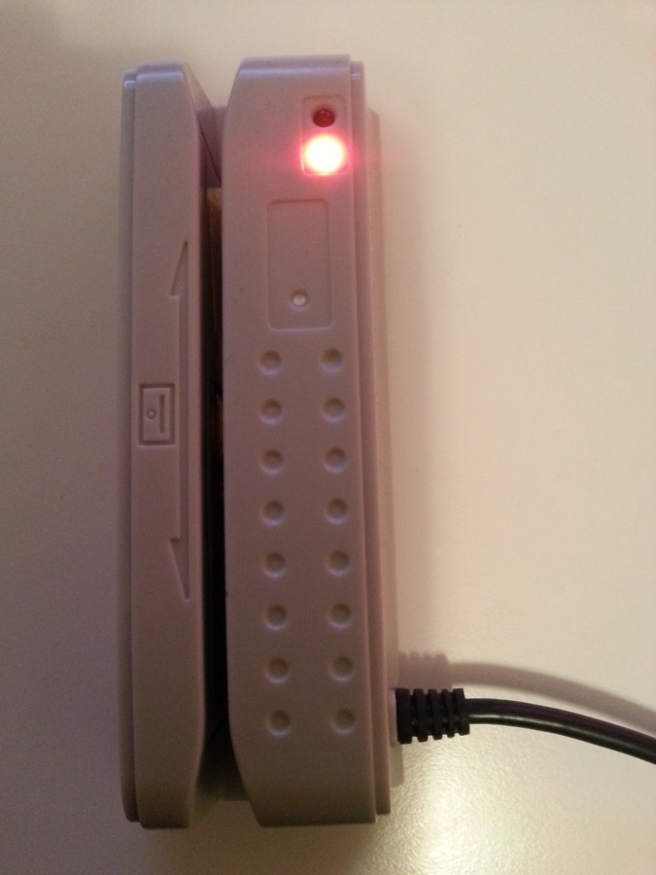
Card Reader
Connects to USB port on Raspberry Pi
Reads & parses student ID (9-digit) from ISU card
Used to track users within database

Slide 7
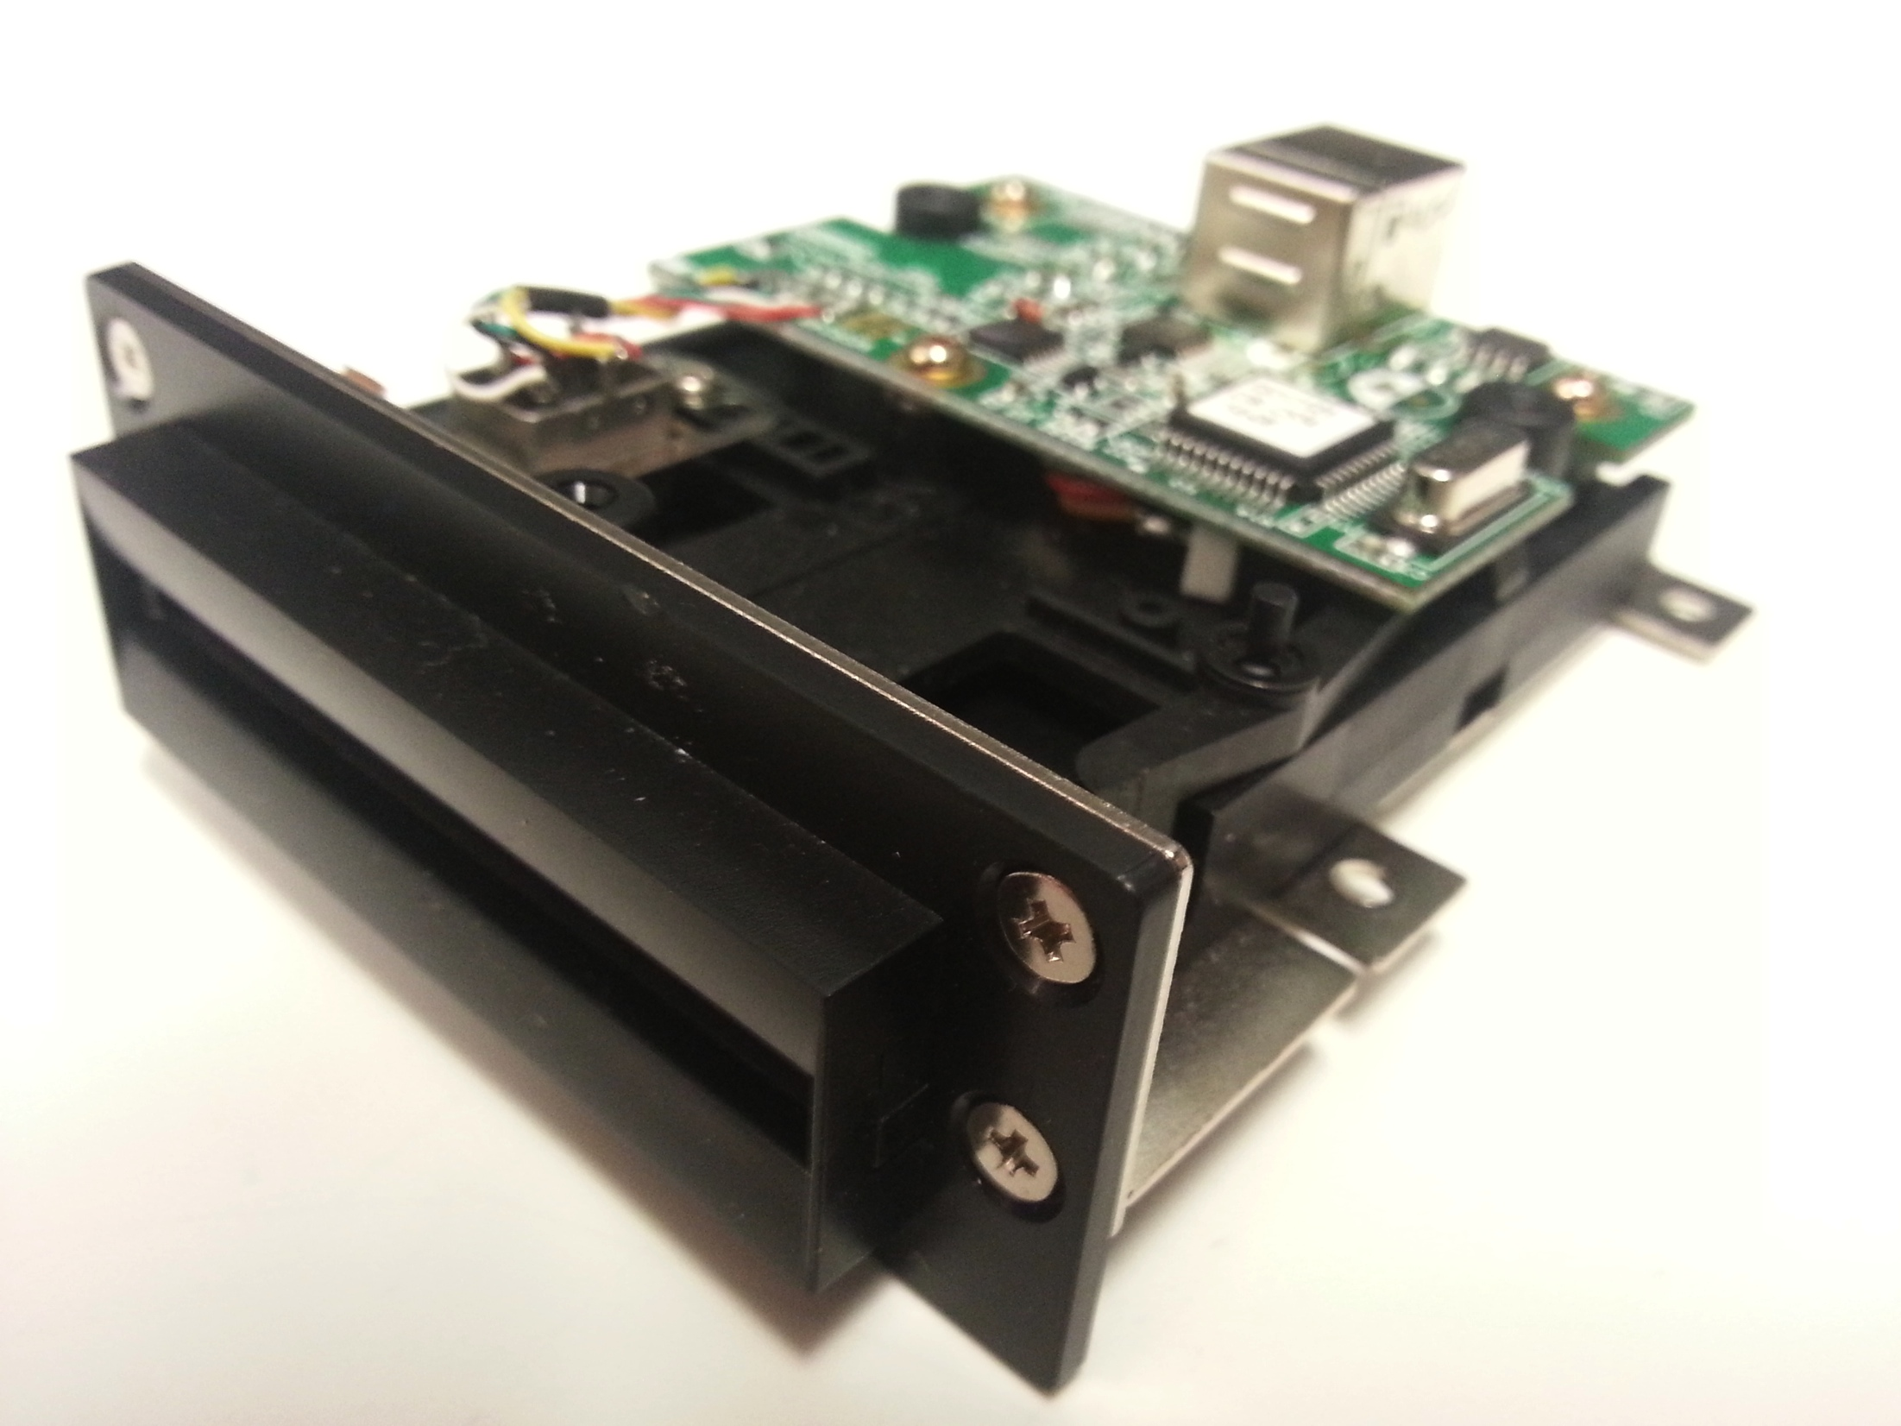
Failed Card Reader
Half Track Insert Reader
Worked with manufacturer to troubleshoot reading issues
Found it was unable to read full data tracks
Scrapped use in project

Slide 8
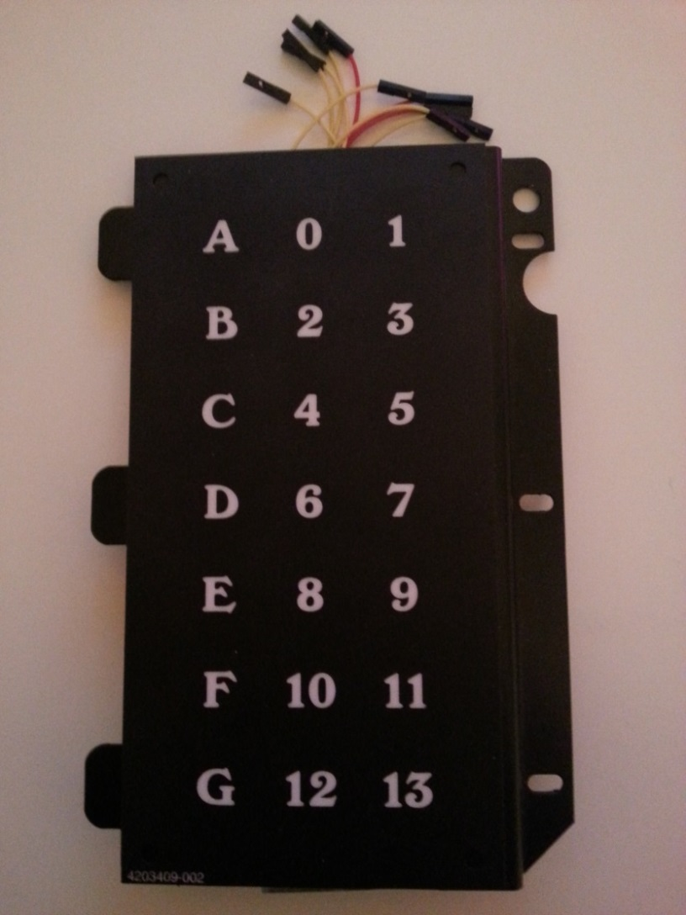
Keypad
10-pin matrix
Connected to GPIO pins on Raspberry Pi
Functionality
Read pressed column
Read pressed row
Get value from pre-determined 2d array

Slide 9
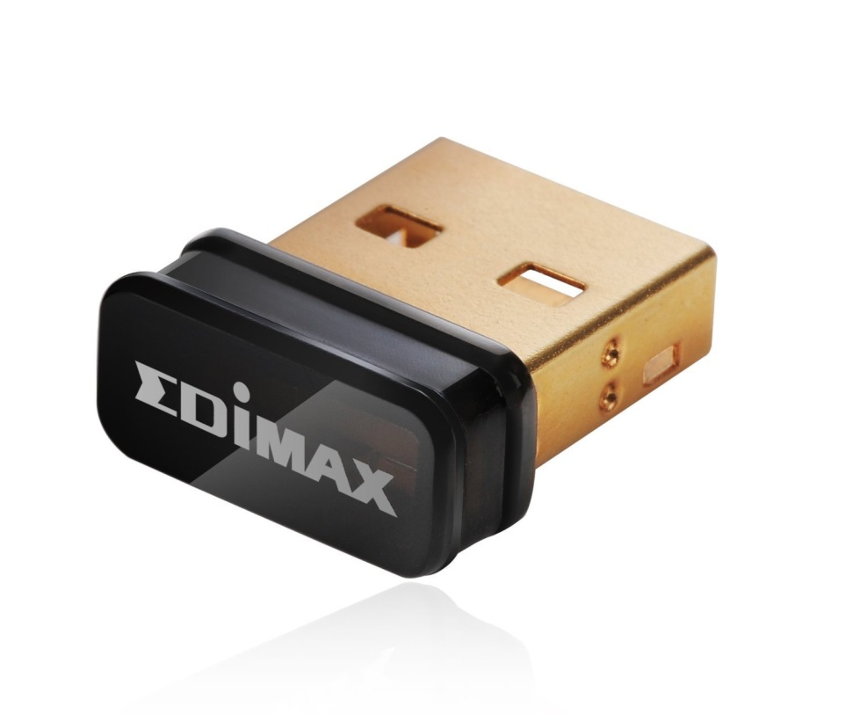
USB Wireless Adapter
Transmits network data from Raspberry Pi to IASTATE wireless network
Uses
SSH access to machine
Admin webpages
Database backups

Slide 10
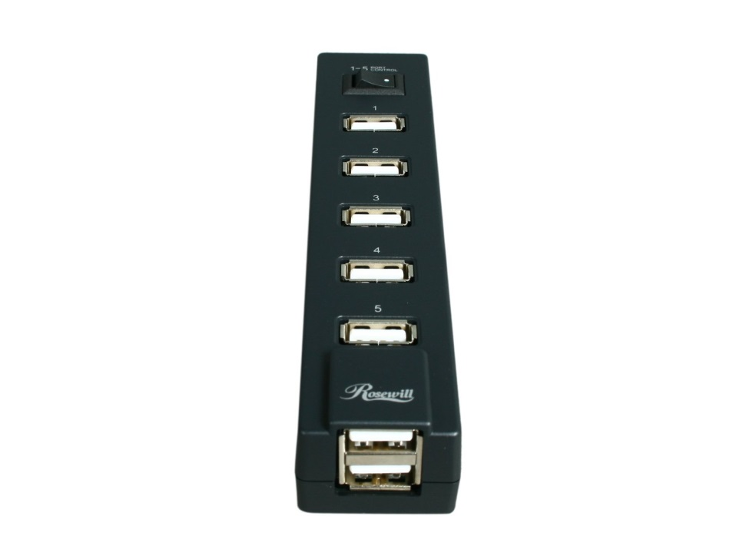
Powered USB Hub
Plugs in through standard wall adapter
Supplies power to
Raspberry Pi
Wireless network adapter
Card Reader
Feeds data to computer through micro-USB cable

Slide 11
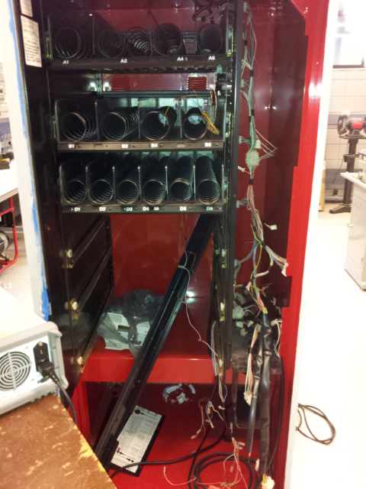
Vending Machine Case
We were provided a used electronic snack vending machine by Lance made in 1999.
Case had suffered dents scrapes and rust. The previous lock had been forcibly removed before our possession.
Much of the internal wiring and fixtures were unnecessary for our purpose and removed.

Slide 12
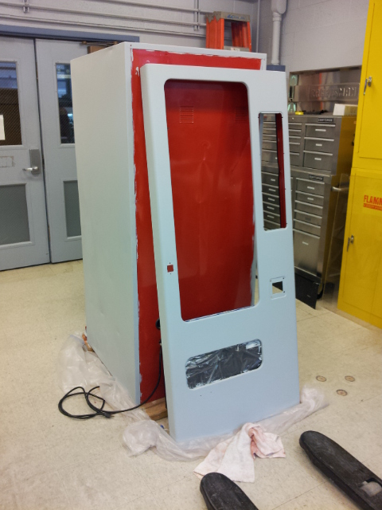
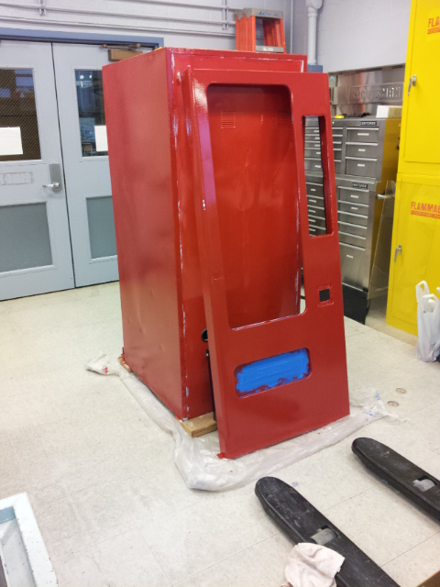
Refinishing the Case
Removed unnecessary parts
Cleaned out buildup of dirt/muck.
Used power hand grinder to smooth out jagged cuts around the lock.
Sanded with power hand sander with 100, 150, and 220 grit sandpaper.
Spray painting method was not optimal; used enamel oil-based primer and 2 gloss coats of paint, sanding with 220 grit sandpaper between coats.

Slide 13
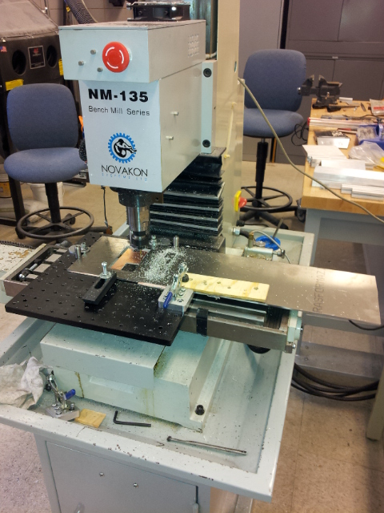
Front Panel
Needed a new front panel for new configuration
LCD, magnetic strip card reader, original matrix keypad.
Panel cut using CAD and metal miller, and assembled by hand.

Slide 14
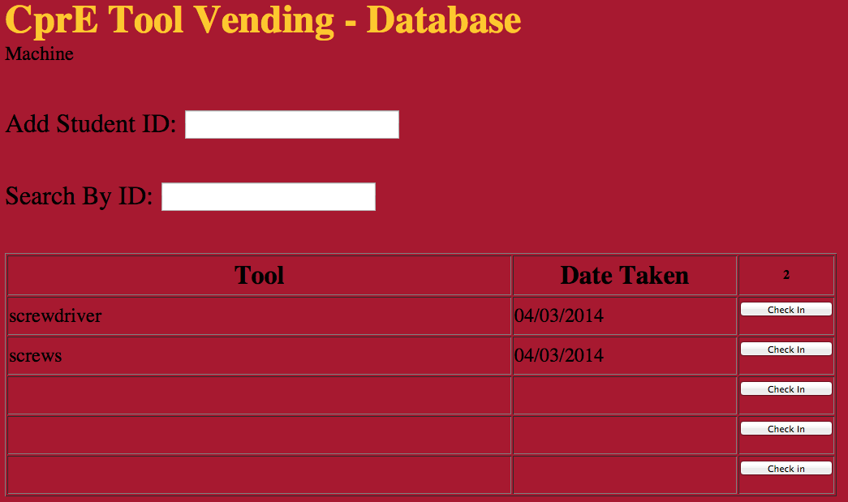
Admin – Students

Slide 15
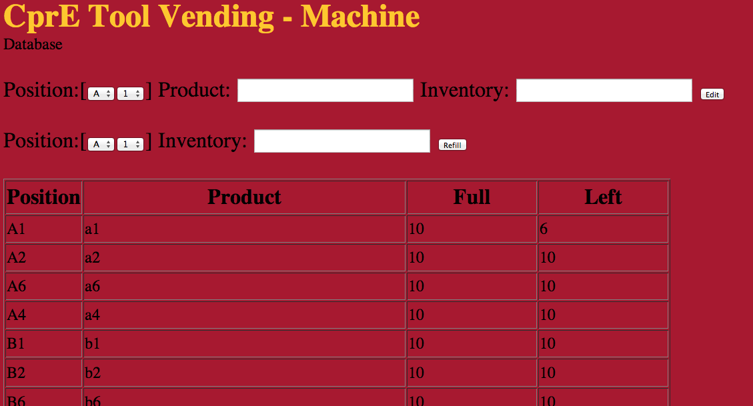
Admin – Machine

Slide 16
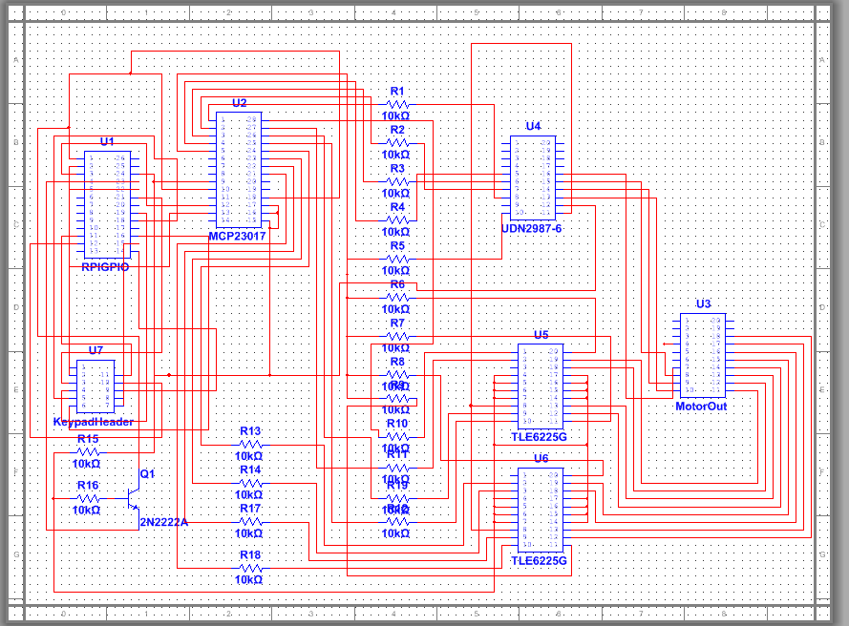
Circuit Schematic
Original PCB design for our motor controller
Controller accepts 3.3V input directing which motor to turn and high side and low side drivers with logic input allow 24 volts to flow to the motors
Faulty hardware caused over current in the drivers often

Slide 17
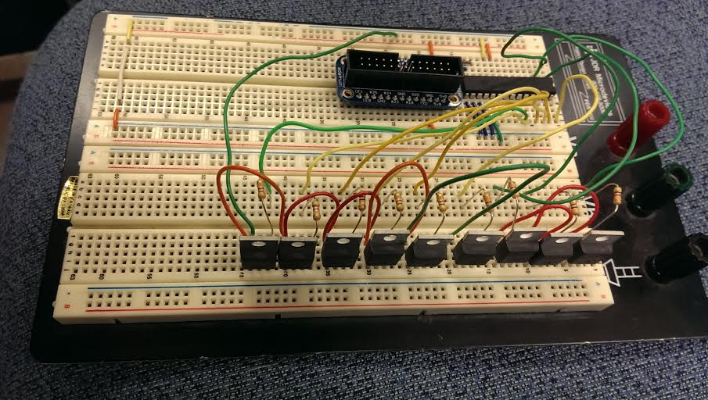
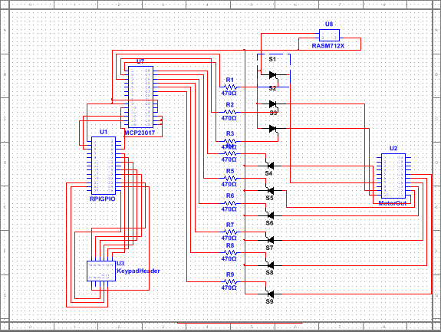
Circuit
Adapted to issues by switching to a circuit configuration using triacs.
More reliable and low current – allowed for more individual component testing and replacement.

Slide 18

Video

Slide 19
Logistical Challenges
Motor drivers and gpio extender
Burnt out during testing
SD card corruption
Rebuilt OS from recent backup
Parts reimbursement
Individually purchased components/supplies
Machine touchups
Difficult to work on due to weather conditions

Slide 20
Testing Plan
Parts functionality testing
Motors
Screen
Keypad
Computer
Machine testing
All components work together correctly
Program does not fail over long periods of time

Slide 21
Final Testing
Magnetic card reader software failure
Simplified code
Database failure
MySQL server would not start
Removed and reinstalled, still not starting
Implemented workaround (commented out database functions)
Keypad connections unreliable
Wiring needed reseating occasionally
Reboot of system

Slide 22
Final Testing
GPIO extender burned out
Make use of remaining GPIO pins on Raspberry Pi
LCD Screen cross-communication
Swiping card or using keypad affects display settings
Motor harness wiring
Contacts are larger than wires used
Fix will be use of larger wire gauge between GPIO and motors

Slide 23
Possible Critical Scenarios
Power Outage
Possible SD card corruption
Maintain OS & database backups
Documentation of equipment and supplies necessary for future scenarios such as:
Dead equipment
Overheating
Vandalism

Slide 24
End
May 1416

